Slide 1
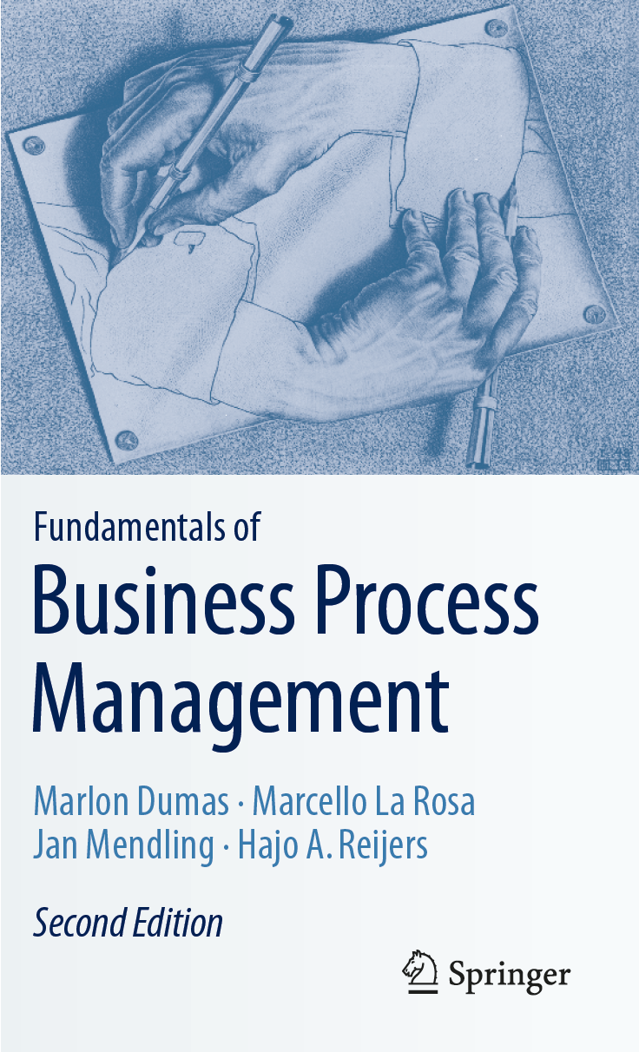
Chapter 12: BPM as an Enterprise Capability
Contents
Barriers to BPM Success
The Six Success Factors of BPM Maturity
Strategic Alignment
Governance
People
Culture
Measuring Process Maturity and BPM Maturity
Recap

Slide 2
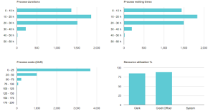

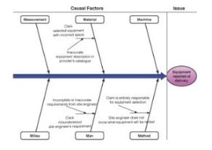
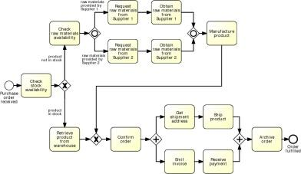

BPM as an Enterprise Capability

Slide 3
Chapter Overview
In this book we presented a range of methods and related techniques for the identification, discovery, analysis, redesign, implementation, and monitoring of business processes.
We also discussed software tools and systems that can support us in the application of these methods for the effective management of business processes.
Given a business process in need of improvement, we discussed how a BPM project can be carried out to achieve the desired improvement goals.
Collectively, we call the set of BPM projects within a company a BPM program. Depending on various characteristics, the number of concurrent projects may be high and the scope of the individual projects themselves may be large. As a result, the coordination of the BPM program may become extremely complex.
This chapter deals with the question: “What does it take to successfully manage a BPM program?” We consider BPM as an enterprise capability, which places it at the same level as other organizational management disciplines such as risk management and human performance management.
After introducing the typical reasons for BPM programs to fail, we introduce transversal aspects of BPM, such as governance and strategic alignment, and discuss how these are critical to avoid the fail reasons.
Next, we organize these aspects in a BPM maturity model and show how to use this model to assess the BPM maturity of an organization.

Slide 4
Chapter 12: BPM as an Enterprise Capability
Contents
Barriers to BPM Success
The Six Success Factors of BPM Maturity
Strategic Alignment
Governance
People
Culture
Measuring Process Maturity and BPM Maturity
Recap

Slide 5
Common Reasons for Failure of BPM Programs
A sole focus on BPM methods and tools, not on business goals,
The belief that BPM is the single source of truth,
BPM projects that are managed as isolated silos, and
An overall inability to change.

Slide 6
Exercise 12.1: Success of BPM Program
Indicate to what extent the following activities can be considered a success for a BPM program. For your assessment, try to distinguish between prerequisites and measures of success. Prerequisites for success are those activities conducive to or necessary for the eventual success of a BPM program, but are not an end in themselves. In contract, measures of success are activities that relate to the achievement of a business goal through BPM.
The BPM team has correctly configured a modeling tool.
A process analyst has completed a Six Sigma training course.
The job description of a process owner has been updated.
The cycle time of the order-to-cash process was reduced by 5%.
A BPMS was installed.
The handling time of over 90% of claims was reduced to up to five days.
The process architecture was updated.

Slide 7
Chapter 12: BPM as an Enterprise Capability
Contents
Barriers to BPM Success
The Six Success Factors of BPM Maturity
Strategic Alignment
Governance
People
Culture
Measuring Process Maturity and BPM Maturity
Recap

Slide 8
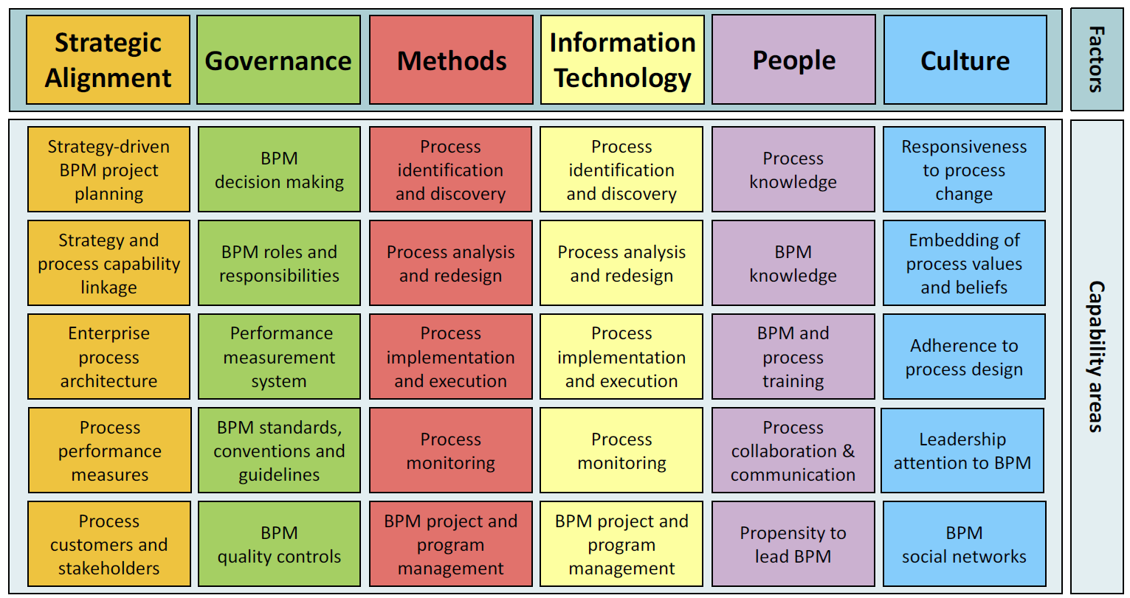
The BPM Maturity Model

Slide 9

Exercise 12.2: Six BPM Success Factors
In recent years, many companies have started initiatives towards digital transformation, better customer experience, and regulatory compliance. Partially, these initiatives are operationalized by the help of BPM programs. Rabobank is one of the largest financial service providers in The Netherlands. In a white paper, Pieter van Langen, a senior manager with Rabobank, reports on their BPM program and the way they use ARIS as a process modeling tool.
Which of the six BPM critical success factors does Van Langen’s report refer to?
“The speed and quality of our application development deter-mines how our customers experience the service. [. . .] There-fore, we can’t afford any mistakes in our software. This is all the more true now that the supporting role of employees at local member banks is disappearing. Processes must be fully functional. At the same time, we must make sure that we can promptly anticipate customers’ desires and comply with laws and regulations. This requires clear-cut and transparent pro-cesses for software development. [. . .] If we develop an appli-cation for an innovative mobile service, it is crucial to know exactly what its impact will be on the environment and other systems and processes. We use models to do this. [. . .] We wanted to be able to find and maintain all system document-tation related to our IT in one central location. [. . .] Moreover, we wanted everyone, from the business analyst to the archi-tect, to be able to count on the fact that the retrieved system documentation will be correct, and that everybody can feel confident in using it. [. . .] In this way we have more control over the quality of the applications we develop. These benefits directly translate into a better service for our customers.”
Source: https://info.softwareag.com/rs/858-DJP-749/images/SAG_Rabobank_RS_Aug16_web_tcm16-129443.pdf

Slide 10
Strategic Alignment
Strategy-driven BPM project planning: How aligned are the methods and tools we choose in each phase of the BPM lifecycle to the particular business goals we want to achieve?
Strategy and process capability linkage: Does the business strategy directly influence the business processes and vice versa?
Enterprise process architecture: How well is the enterprise process architecture specified?
Process performance measures: How well are process outcomes and related process performance measures defined?
Process customers and stakeholders: How well is the view of customers and other process stakeholders incorporated in BPM projects?

Slide 11

Exercise 12.3: Strategic Alignment
In a case study, Reisert, Zelt, and Wacker report on the corporate strategy of the software vendor SAP and the way how they used BPM to achieve their goals.
Which capability areas associated with strategic alignment are described?
“In order to produce innovative solutions faster and more simply, SAP started in 2008 to transform its research and development processes. SAP moved away from complex and static project methods toward agile and simple pro-cesses, thereby significantly reducing the throughput time of the standard innovation cycle. Based on the experience of this trans-formation and optimi-zation, [. . .] SAP decided to increase the emphasis on Business Process Management (BPM). Therefore, BPM initiatives were implemented on a company-wide level in the effort to establish a process infrastructure and a process improvement culture. [. . .] The key success factor in SAP’s journey from BPM concepts and ideas to measurable impact [. . .] was the strategic alignment of BPM with top management support. [. . .] The Process Manager is responsible for defining the process improvement goal (with approval from the Business Owner), which is typically derived from the SAP strategy (im-provement portfolio, strategic objectives), from a current issue in the process (impediment, audit finding), or from an idea from the SAP idea management initiative. [. . .] The effect of the process changes are measured according to Process Performance Indicators (PPIs), which in-clude throughput time, cus-tomer satisfaction, and cost per unit output. These PPIs are measured by the Process Manager and compared with pre-viously defined success criteria. [. . .] Although the triggers for actual process improvement can be numerous, the [. . .] activities involved in improving a process are standardized and, as such, are documented in the SAP Process Map.”
Reisert, Zelt, Wacker: How to move from paper to impact in business process management: The journey of SAP. In vom Brocke, Mendling, eds.: Business Process Management Cases. Springer-Verlag, 2018. http://www.bpm-cases.com/projects/how-to-move-from-paper-to-impact-in-business/

Slide 12
Governance
BPM decision making: What BPM decisions can be taken and when, to handle both expected and unexpected circumstances?
BPM roles and responsibilities: Is there a clear definition of BPM roles and associated responsibilities?
Process performance measurement system: What mechanisms are in place to measure process performance and how appropriate are these mechanisms based on the chosen performance measures?
BPM standards, conventions, and guidelines: How well are BPM standards, conventions, and guidelines defined?
BPM quality controls: What control measures are in place to review and guarantee quality in all phases of a BPM project?

Slide 13
Exercise 12.4: Governance
In a case study, Reisert, Zelt, and Wacker report on the governance of BPM at SAP.
Which capability areas associated with governance are described?
“As the transformation significantly reduced the standard innovation cycle’s throughput time, SAP decided to build on this success and founded the Productivity Consulting Group (PCG). [. . .] PCG was founded as a process office with direct oversight over SAP’s corporate functions throughout all regions. The PCG is responsible for establishing a process infrastructure in the company, including process governance, idea management, and improvement services. The PCG is located in the area of SAP’s COO [the Chief Operations Officer], which facilitates a direct connection between the PCG’s portfolio and the corporate strategy. By grouping PCG with an organizational unit called Business Insight and Technology, the company ensures a close relationship with IT projects and innovations. [. . .] PCG manages the SAP Process Map and provides SAP-wide BPM standards on how to design, measure, and improve processes. It also manages the BPM community, which entails educating the Process Managers on BPM methodology. Process Managers are responsible for defining, operating, and improving processes, so they pursue the business goals, strategies, and objectives defined by Business Owners. [. . .] The effect of the process changes are measured according to Process Performance Indicators (PPIs). [. . .] SAP uses its own process maturity model that has been tailored to the company’s needs.”
Reisert, Zelt, Wacker: How to move from paper to impact in business process management: The journey of SAP. In vom Brocke, Mendling, eds.: Business Process Management Cases. Springer-Verlag, 2018. http://www.bpm-cases.com/projects/how-to-move-from-paper-to-impact-in-business/

Slide 14
People
Process knowledge: To what level do process participants and related process stakeholders know the processes they participate in?
BPM knowledge: How much do the people in BPM roles, such as process analysts, know about BPM methods and tools?
BPM and process training: How developed is the corporate training in BPM and business processes?
Process collaboration and communication: How do process stakeholders collaborate and communicate with each other for the achievement of process objectives?
Propensity to lead BPM: How willing is a company’s management team to lead BPM projects?

Slide 15
Exercise 12.5: People
Continuing with the case study by Reisert, Zelt, and Wacker, the extract below reports on the activities of the Productivity Consulting Group (PCG), which is in charge of BPM at SAP and of the people in relation to BPM activities.
Which capability areas associated with people are described?
“The PCG supports a series of communication and enablement activities in order to establish a solid relationship with the BPM community.
SAP Process Excellence Newsletter: Bi-monthly issues that contain training offers, information on upcoming events and success stories on process improvement.
Process Manager Information Sessions: Bi-monthly sessions for Process Managers to share best practices and roll out information about BPM standards.
Process Management Training: Classroom and virtual training sessions on [SAP’s] BPM methodology, tools, and best practices (from Process Managers for Process Managers).
SAP Process Summit: Annual event where all Process Managers come together to exchange best practices, get inspiration from external speakers, and learn about new topics related to BPM.
SAP Process Excellence Award: Increases the visibility of excellent processes and provides a platform for employees who are working on process improvement by rewarding outstanding processes that accomplish measurable process improvements and have a positive impact on the company.”
Reisert, Zelt, Wacker: How to move from paper to impact in business process management: The journey of SAP. In vom Brocke, Mendling, eds.: Business Process Management Cases. Springer-Verlag, 2018. http://www.bpm-cases.com/projects/how-to-move-from-paper-to-impact-in-business/

Slide 16
Culture
Responsiveness to process change: To what extent does the organization embrace and respond to continuous process change?
Embedding of process values and beliefs: How deep is process-thinking ingrained in the corporate values and beliefs?
Adherence to process design: To what degree do process participants adhere to process designs?
Leadership attention to BPM: How much support do leaders exhibit for BPM?
BPM social networks: Are social network in place to shape and disseminate BPM in the organization?

Slide 17
Exercise 12.6: Culture
The last extract from the case study by Reisert, Zelt, and Wacker reports on the results and lessons learned from the way SAP embraced BPM.
Which results can be related to the capability areas associated with culture? Consider also the descriptions for Exercise 12.5.
“With the implementation of the SAP Process Map and easy-to-use tools for process documentation, process modeling has become an important part of Process Managers’ jobs. Currently, 626 employees have an editor user for process modeling, and more than 1,200 employees are enrolled in internal training that helps them to design and leverage processes at SAP. Today, 92% of all Level 3 processes are documented and published in the SAP Process Map, and 1,023 processes on Level 3 and below are documented. [. . .] Based on a sample of 100 projects per year, SAP currently achieves a typical result of 20:1 payback and a customer satisfaction that exceeds 75%. In addition, many processes’ processing time has been reduced significantly, including a process in the marketing services team that eliminated eleven process steps and reduced processing time by up to 74%. [. . .] A strong BPM community and a culture that supports BPM initiatives, where every single employee contributes to process improvement, are essential. SAP established the Process Excellence Award, process management events, and other activities that contribute to the creation of a process management culture and a deeper understanding of the value of BPM.”
Reisert, Zelt, Wacker: How to move from paper to impact in business process management: The journey of SAP. In vom Brocke, Mendling, eds.: Business Process Management Cases. Springer-Verlag, 2018. http://www.bpm-cases.com/projects/how-to-move-from-paper-to-impact-in-business/

Slide 18
Chapter 12: BPM as an Enterprise Capability
Contents
Barriers to BPM Success
The Six Success Factors of BPM Maturity
Strategic Alignment
Governance
People
Culture
Measuring Process Maturity and BPM Maturity
Recap

Slide 19
Process Maturity
Assessment of how broad and deep a given spectrum of business processes is.
Supported by Capability Maturity Model Integration (CMMI) by the CMMI Institute.
Level 1 (Initial),
Level 2 (Managed),
Level 3 (Defined),
Level 4 (Quantitatively managed),
Level 5 (Optimizing)

Slide 20
BPM Maturity
Assessment of how broad and deep the spectrum of BPM activities is.
Level 1 (Initial): BPM is nonexisting or rarely used. When available, BPM projects are carried out in an ad hoc fashion within individual divisions. Such initiatives are uncoordinated, limited scope and minimal employee involvement.
Level 2 (Managed): The organization starts capitalizing on its first BPM experiences to build up BPM capabilities. A process-thinking mindset starts to emerge among its employees. As the awareness of BPM increases, the first processes are documented and analyzed. There is also increasing involvement of the management level, though knowledge of BPM methods and tools remains with external experts.
Level 3 (Defined): The organization reaps the benefits of the first BPM projects, though the focus is still on the early stages of the BPM lifecycle. The use of methods and tools becomes more sophisticated. In-house BPM training is established to reduce the dependence upon external experts. The first process collaboration and communication forums are set up to facilitate the dissemination of BPM experiences (e.g., using intranets to share process models).
Level 4 (Quantitatively managed): The focus of BPM projects shifts towards the last phases of the lifecycle: change management accompanies BPM projects to guarantee the acceptance of the redesigned processes; systematic performance monitoring ensures that BPM projects deliver strategic benefits. A BPM Center of Excellence is established with well-defined roles to coordinate all BPM efforts. There is process orientation in every project (not only in BPM-specific ones) and the company minimally relies on external expertise.
Level 5 (Optimizing): BPM is fully-established, on both the operational level and the strategic level, where it has become an integral part of any manager’s activities, accountabilities, and performance measurements. BPM methods and tools are widely accepted and a standardized, company-wide approach to BPM is in place. As BPM becomes the way business is done, the BPM Center of Excellence reduces in size.

Slide 21
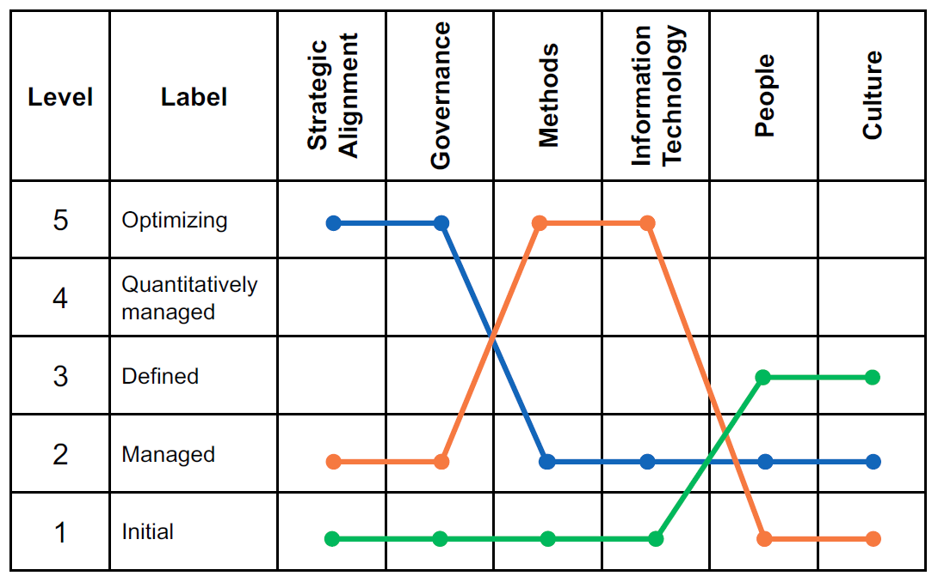
Patterns of BPM Maturity
Blue pattern:
High maturity in strategic alignment and governance, low elsewhere.
Typical of organizations where BPM is driven from top, e.g., sponsored by the CFO or CEO.
Strong executive support for BPM, often because of a sense of urgency.
Orange pattern:
High maturity in methods and IT, low elsewhere
Typical of organizations where BPM is driven under the sponsorship of CIO.
Strong emphasis on BPM methods and software solutions.
Green pattern:
medium maturity in people and culture, low elsewhere
Typical in organizations that are affected by rule-based governance and heavy unionization, where everyone’s buy-in is sought for any redesign decision.

Slide 22
Exercise 12.7: BPM Maturity of SAP
In Exercises 12.3 to 12.6, we have learned about the BPM program at SAP.
Assess the BPM maturity of SAP from what is reported in the quoted text.

Slide 23
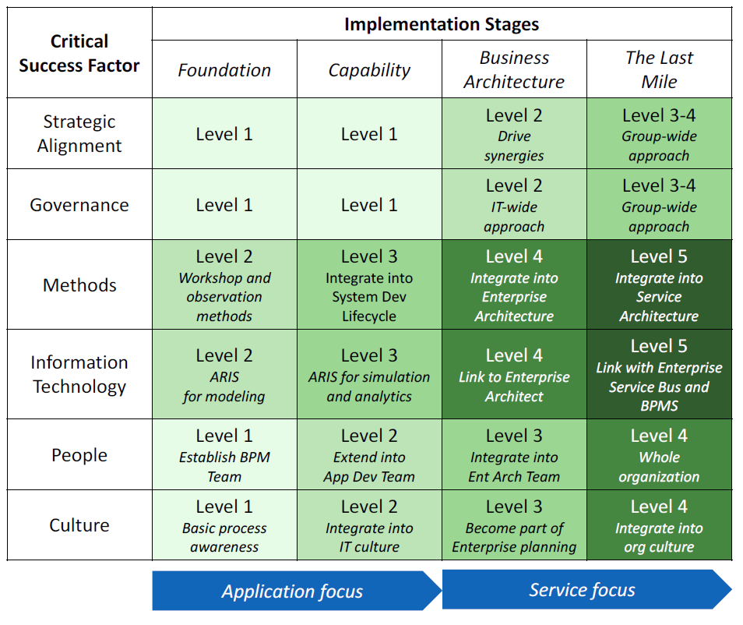
Example of BPM maturity assessment for an insurance company
The Figure shows an example of BPM maturity assessment for an insurance company.
The assessment is framed in the context of a BPM roadmap, which describes desired levels of maturity over time.
The company in this example follows the orange pattern: The driver for BPM is methods and IT, rather than strategy.

Slide 24
10 Principles of Good BPM
Principle of Context Awareness: BPM should fit the organizational context. It should not follow a cookbook approach.
Principle of Continuity: BPM should be a permanent practice. It should not be a one-off project.
Principle of Enablement: BPM should develop capabilities. It should not be limited to firefighting.
Principle of Holism: BPM should be inclusive in scope. It should not have an isolated focus.
Principle of Institutionalization: BPM should be embedded in the organizational structure. It should not be an ad hoc responsibility.
Principle of Involvement: BPM should integrate all stakeholder groups. It should not neglect employee participation.
Principle of Joint Understanding: BPM should create shared meaning. It should not be the language of experts.
Principle of Purpose: BPM should contribute to strategic value creation. It should not be done for the sake of doing it.
Principle of Simplicity: BPM should be economical. It should not be over-engineered.
Principle of Technology Appropriation: BPM should make opportune use of technology. It should not consider technology management as an afterthought.

Slide 25
Chapter 12: BPM as an Enterprise Capability
Contents
Barriers to BPM Success
The Six Success Factors of BPM Maturity
Strategic Alignment
Governance
People
Culture
Measuring Process Maturity and BPM Maturity
Recap

Slide 26
Recap
This chapter argued that to achieve sustainable success with BPM, we need to go beyond the application of methods, techniques, and software tools, and consider BPM as an enterprise capability embedded in the corporate structure.
Accordingly, BPM should not be seen as a one-off project, but as a coordinated set of projects developed over time, each of these aiming to improve one or more business processes via the BPM lifecycle.
First, we presented typical fail reasons of BPM programs, and traced these back to a lack of strategic alignment, a weak or nonexistent governance structure, or an underestimation of the role that employees and corporate culture play for the success of the BPM program.
We then introduced the BPM Maturity Model as a tool to measure the success, or maturity, of a BPM program within an organization. This model revolves around six critical success factors: strategic alignment, governance, methods, IT, people, and culture, each sporting five capability areas. The underlying assumption is that BPM success influences business process success, which in turn influences business success.
Regarding maturity assessment, we differentiated between BPM maturity and process maturity. The former measures the completeness and quality of the set of processes executed in an organization; the latter measures the maturity of the BPM program that drives the management of these processes.
We overviewed the CMMI framework for process maturity assessment, and reused the nomenclature of its maturity levels to discuss five levels of BPM maturity according to the BPM Maturity Model. From this, we delineated three key patterns of BPM adoption within companies.

